Slide 1
Introduction to Data Basin
A Web Mapping Platform: nalcc.databasin.org
Renee farnsworth
Gis analyst
North Atlantic lcc

Slide 2
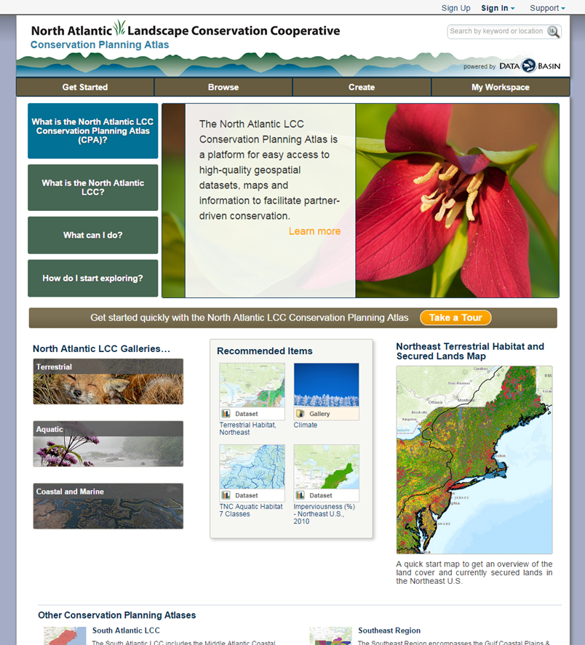
NALCC CPA
Hub for regionally consistent data
Explore what’s available and view metadata
Visually compare multiple datasets
Create and share maps
Download data

Slide 3
NALCC CPA Homepage
Account is free
Email required
Import data
Save maps

Slide 4
DROP DOWN MENU

Slide 5
DROP DOWN MENU

Slide 6
NALCC CPA Homepage
Search keyword(s)
Or click the magnifying glass

Slide 7
SEARCH FUNCTION
Can search other LCC’s or all of Data Basin

Slide 13
Feedback Please!
How can we make our cpa on DataBAsin more useful?
Is this a tool you will use?
If you are already using this tool, how?
Contact us with any comments or questions:
Renee Farnsworth
renee_vieira@fws.gov
BJ Richardson
bj_richardson@fws.gov

